Slide 1
CS 350 Operating Systems Spring 2024
Lab 7: pthread basics

Slide 2
Basic usage of the pthread library
In this lab, you will practice the basic usage of pthread library functions.
pthread_create()
pthread_join()
…

Slide 3
The task
The main thread creates two new threads (T1 and T2), which print the user input in different ways.
T1 prints the user input in a forward way.
T2 prints the user input in a backward way.
User also specifies the total number of prints that T1 and T2 together should output.
./pt_task total_number_prints list-of-user-arguments
After T1 and T2 terminate, the main thread prints the numbers of times that T1 and T2 each printed (the sum of which should equal to “total_number_prints” specified by the user).

Slide 4
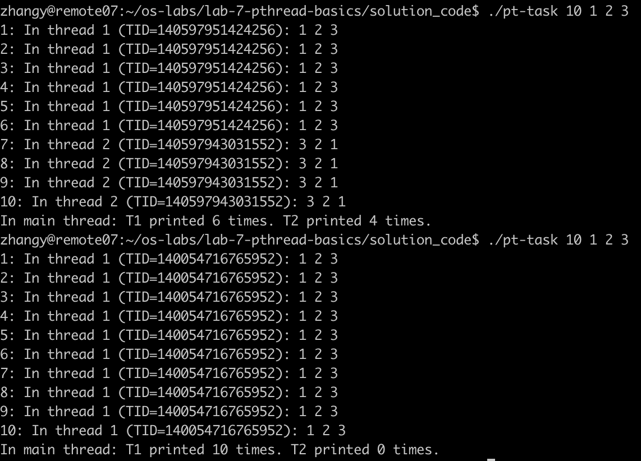

Slide 5
Hints and question
You will need provide the “-lpthread” option to gcc to link your code with the pthread library (the Makefile already does that).
One of the thread synchronization facilities needs to be used to ensure the correct output as shown in the previous slide.
As you will see, the scheduling of the two threads is indeterministic. You may think about how you can ensure deterministic result by using the knowledge learned in class?
Notes:
To answer the question: both conditional variable and semaphore are good options to ensure deterministic result.

